Slide 1
VOICE RECOGNITION FOR FAIL SAFE COMMANDS
Presenter : Mayank Rupesh Raut
Department: IADD,BARC
Mentor: Mr. Arindam Basu

Slide 2
PROBLEM STATEMENT
Commands must be validated and executed securely to avoid incorrect operation
Implement robust speaker verification to ensure secure system access
Develop a reliable voice-based control system for accurate command execution
Integrate the system with the EPICS environment for command execution
There is a need for a secure, efficient, and voice-based interface for hands-free operation
Enable hands-free operation and increased accessibility and reduced cognitive load

Slide 3

OBJECTIVE
Advanced Voice Recognition Development
Speaker Authentication & Access Control
Expanded Fail-Safe Command Set
Control System Integration
Implement safe shutdown sequences instead of abrupt stops.
Logging, Auditing & Compliance
Graphical User Interface & Monitoring

Slide 4
INTRODUCTION TO LEHIPA
LEHIPA (LOW ENERGY HIGH INTENSITY PROTON ACCELERATOR) IS AN LINEAR ACCELERATOR
It is the front end part for ADS – Accelerator Driven Subcritical reactor system.
DESIGNED TO ACCELERATE PROTON BEAM FROM 50 KeV TO 20 MeV
LEHIPA CONSISTS :
Ion Source → Generates H⁺ (proton beam)
LEBT (Low Energy Beam Transport) → Beam focusing and transport
RFQ (Radio Frequency Quadrupole) → Initial acceleration and bunching
DTL (Drift Tube Linac) → Further acceleration to higher energy

Slide 5
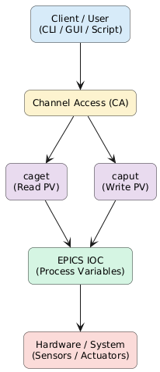
EPICS Control System
EPICS (Experimental Physics and Industrial Control System) distributed control system framework developed collaboratively by major accelerator labs all over the world.
Each field operation of the system is linked to EPICS process variables (PVs)
Commands are executed by manipulating the PV values, which helps in control and monitoring the system
EPICS allows communication between different sub-sytems of LEHIPA
EPICS uses Channel Access to access the PVs
caput → to change PV values
caget → to check PV values

Slide 6
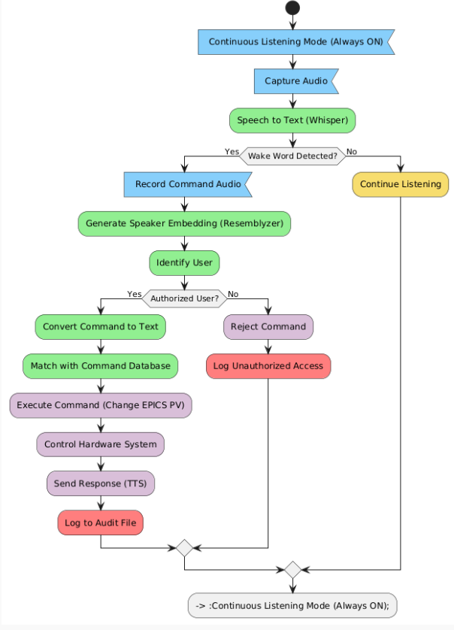
SYSTEM FLOW
System continuously listens for audio input
Speech is converted to text and wake word is detected
If wake word is absent, system continues listening
If detected, command audio is recorded and user is verified
Unauthorized users are rejected and logged
Authorized commands are processed and matched with database
User access is validated based on assigned role (Admin/User)
EPICS PV values are updated to control hardware
System gives TTS feedback, logs actions, and returns to listening

Slide 7
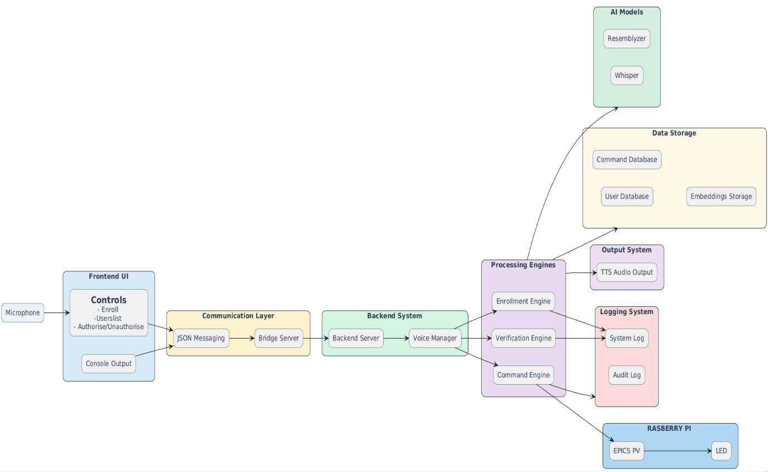
SYSTEM ARCHITECTURE
System captures voice input through microphone and browser-based interface
Communication is handled via a bridge server using TCP/JSON messaging
Backend processes input through a central voice controller module
Processing engines perform verification, command processing, and enrollment
Integrated with Whisper (speech-to-text) and Resemblyzer (speaker verification)
Commands are mapped to EPICS PV control for hardware execution

Slide 8
TECHNOLOGY STACK
Programming Language: Python + JS
Speech Recognition: Whisper
Speaker identification: Resemblyzer
Audio Processing: Sounddevice, Librosa
Control Interface: EPICS (simulated)
Platform: Linux (Ubuntu)

Slide 9
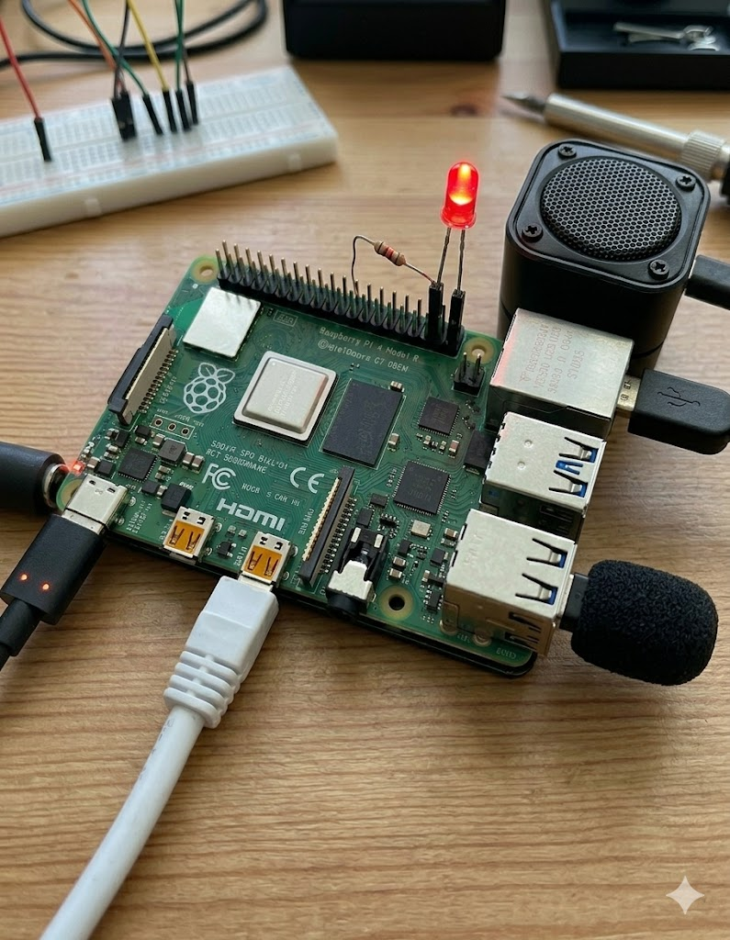

Hardware – Raspberry PI 4
System deployed on Raspberry Pi 4 for execution
Microphone connected for voice input capture
LED connected to GPIO to demonstrate system output
LED state changes (ON/OFF) based on command execution via EPICS PV
Speaker connected for audio feedback using TTS output
Enables complete interaction loop

Slide 10
MODELS USED
Whisper Tiny (Speech Recognition)
Converts audio input into text transcription
Model size on disk: 75 MB
Total data: ~680,000 hours of audio
Transformer-based encoder-decoder model
Trained on large-scale multilingual speech data
Selected due to low computational requirement and CPU compatibility
Handles transcription with acceptable accuracy
Features extracted[whisper]:
Frequency
Temporal
Phonetics
Linguistics

Slide 11
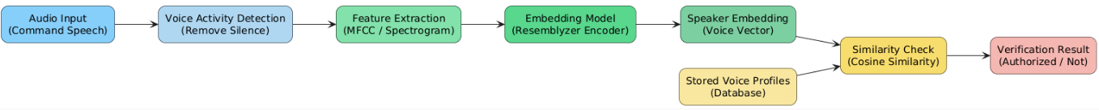
MODELS USED
Resemblyzer (Speaker Verification)
Generates speaker embeddings from voice input
Model size: ~90–100 MB
1000 hours of clean speech data
Embeddings capture unique vocal characteristics
Uses cosine similarity to compare identities
Supports fast and efficient speaker matching
Features extracted[resemblyzer]:
Pitch
Tone
Voiceprint
Style

Slide 12
MODELS REJECTED
Vosk
Faster but lower transcription accuracy
Unable to reliably detect command phrases
Not suitable for precise control operations
The accuracy rate as compared to whisper was 30%
SpeechBrain
Produced noisy and inconsistent outputs
Higher word error rate
Less stable for command recognition
The avg word error rate was more then 0.7 for each command
Other Whisper Variants (Base, Small, etc.)
Higher computational requirements
Increased latency on Raspberry Pi
Not suitable for deployment on this system
The system took 4 -5 seconds more to load and transcript the speech

Slide 13
SYSTEM DEVELOPMENT
Initial model development and testing performed on Megh server environment
Megh machine specs: 11GB RAM, Intel Xeon Gold 6230R CPU @ 2.10GHz, ~100GB storage
Models tested: Whisper, Vosk, SpeechBrain, Resemblyzer
Audio recorded on local system (with microphone) and transferred to Megh using SCP
Voice system tested on multiple users with different command inputs
Whisper identified as the most feasible and accurate model
Final system deployed on Raspberry Pi 4B with microphone and LED for testing

Slide 14
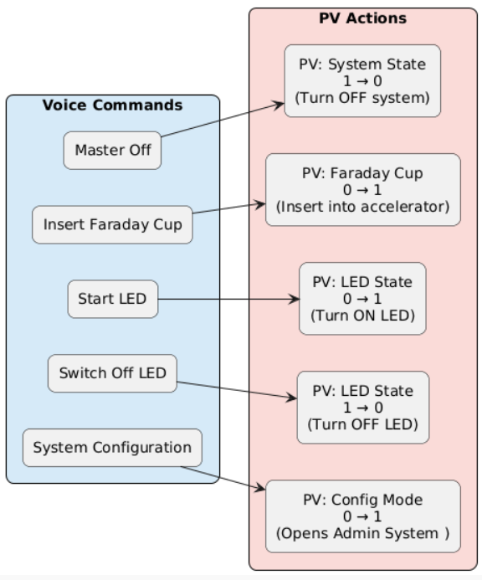
COMMANDS FOR FAIL SAFE SYSTEM
Wake Word Activation System processes commands only after detecting a wake word
Similarity Threshold Matching (0.80) Ensures commands are executed only when closely matching predefined commands
Predefined Command Set (Whitelisting) Only safe and allowed commands are executed
Audio Handling & Processing Filters input using continuous listening and controlled activation
Speaker Verification (Security Layer) Only authorized users can execute commands
System Configuration Command (Admin Access)
Wake Word
(Ready)

Slide 15
ROLE BASED SYSTEM
System implements two roles: Admin and User
Access to system operations is controlled based on user role and authorization
Only verified and authorized users are allowed to execute commands
Prevents unauthorized access and unintended system operations
Role-based design ensures secure and structured control of the system
Admin Role
Enroll new users by capturing and storing voice embeddings
Authorize or remove users from the system
Execute all predefined system commands
Manage access control and system-level operations
User Role
Execute commands only if authorized and verified
Limited access to system functionality
Cannot enroll or manage other users

Slide 16
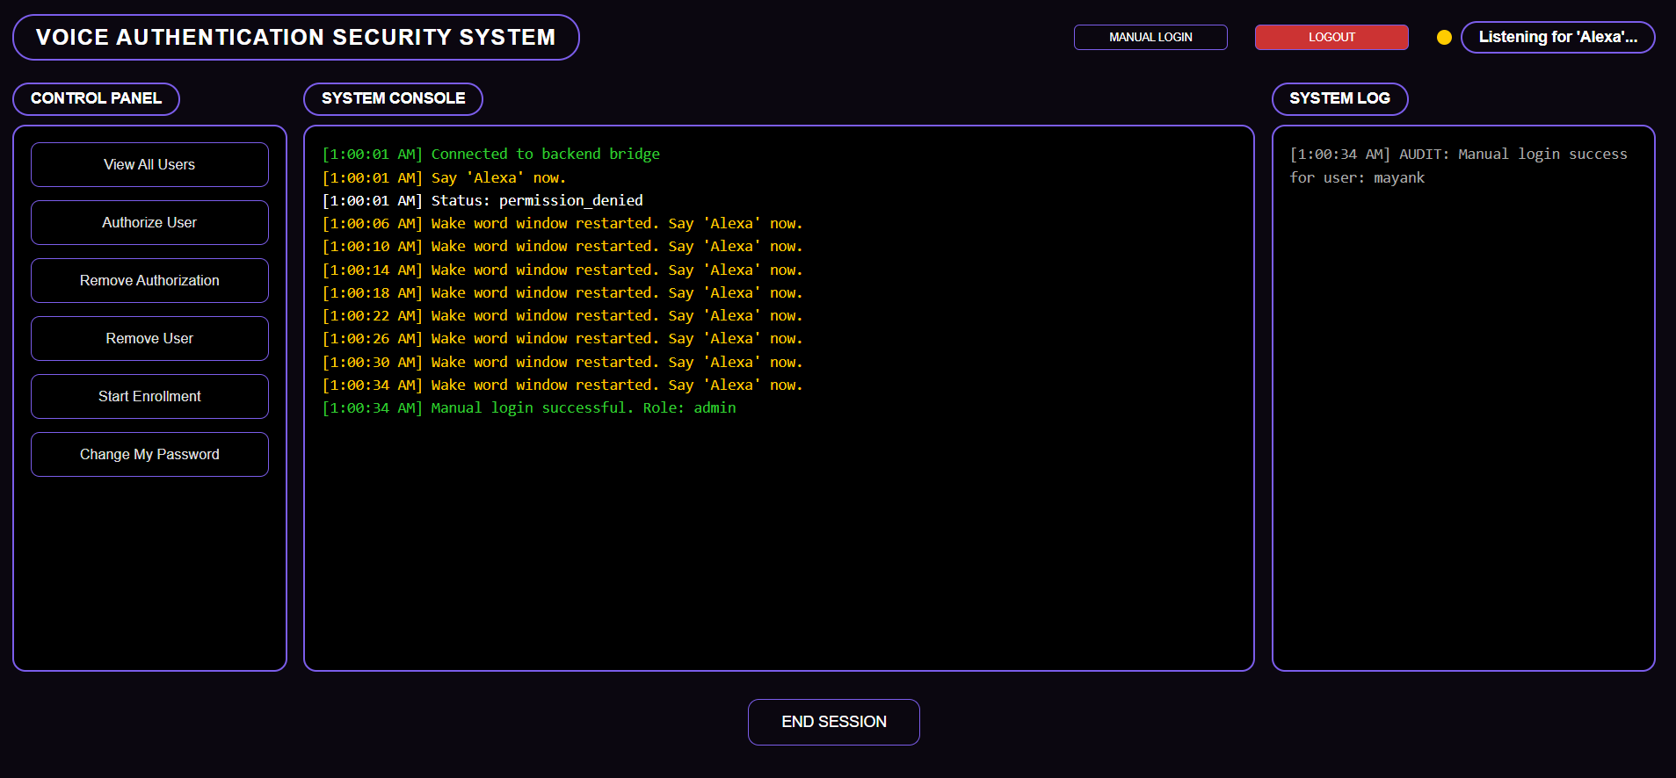
UI INTERFACE
Shows instruction to the user and system logs
State of the program
Login using username/password
Shows attempt and success logs
#colour based logging
*green =success
*yellow = instructions
*red = unsuccessfull attempts
ADMIN ACCESS ONLY
to end ongoing session

Slide 17
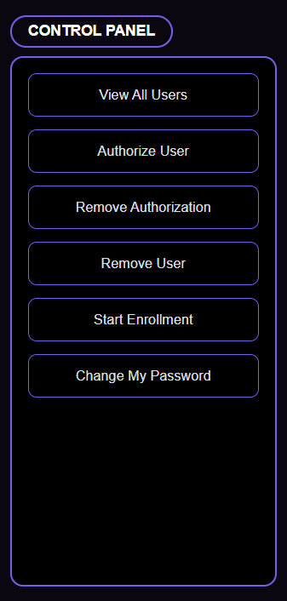
UI INTERFACE
Give the list of all the users
authorizes enrolled users and assigns roles
Remove authorization and can change roles
Removes user from the database
Starts enrollment
Once a user is given the role of admin they can set there own key
ADMIN CONTROL

Slide 18
LIMITATIONS
Whisper may produce minor transcription errors (WER), especially for unclear speech
Speaker verification accuracy decreases with short or low-quality audio samples
System performance is limited by CPU constraints of Raspberry Pi
Background noise can impact speech recognition and verification accuracy
System currently supports only a predefined set of commands
Requires proper threshold tuning for reliable speaker verification

Slide 19
FUTURE SCOPE
Improve speech recognition accuracy using larger or fine-tuned Whisper models
Enhance speaker verification with advanced embedding models and better datasets
Implement noise reduction and filtering techniques for robust performance
Expand system to support dynamic and natural language commands (NLP integration)
Optimize system performance using GPU acceleration or edge AI devices
Develop scalable architecture for multi-user and multi-device environments
Integrate with IoT and industrial automation systems for wider applications

Slide 20
CONCLUSION
Developed a secure voice-based command system for control operations
Successfully integrated speech recognition and speaker verification models
Enabled interaction with EPICS control system using PVs
Implemented role-based access control for authorized access
Achieved end-to-end pipeline from voice input to hardware output
System demonstrates a practical and scalable approach for voice-controlled automation

Slide 21
ACKNOWLEDGEMENTS
I would like to express my sincere gratitude to:
Mr. Arindam Basu (Mentor)
Namrata Ma’am
Bhumesh Sir
Santosh Sir
Deepak Sir
For their valuable guidance, support, and encouragement throughout the development of this project.

